Slide 1

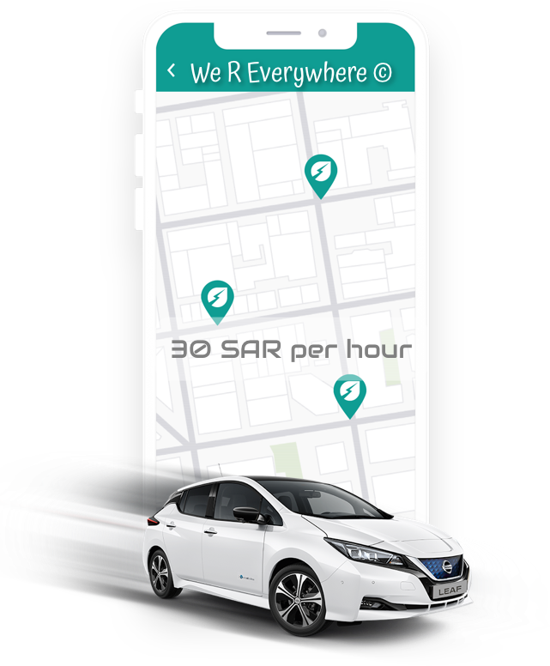
R
R
W
Amwaj Alshamrani Hussain Alibrahim Khulud Alawaji
Mariam Alhawiti Latifah Alhwiseen
e
We R Everywhere
Start where you are. Use what you have. Do what you can

Slide 2
Company Overview
Branchless car rental experience through our mobile application.
Pickup and drop-off cars into different location without any extra fees.
Hire car per hour.
Different cars categories (Small and Family size)
Petrol is covered by the rental price.
Online Payment system.

Slide 3
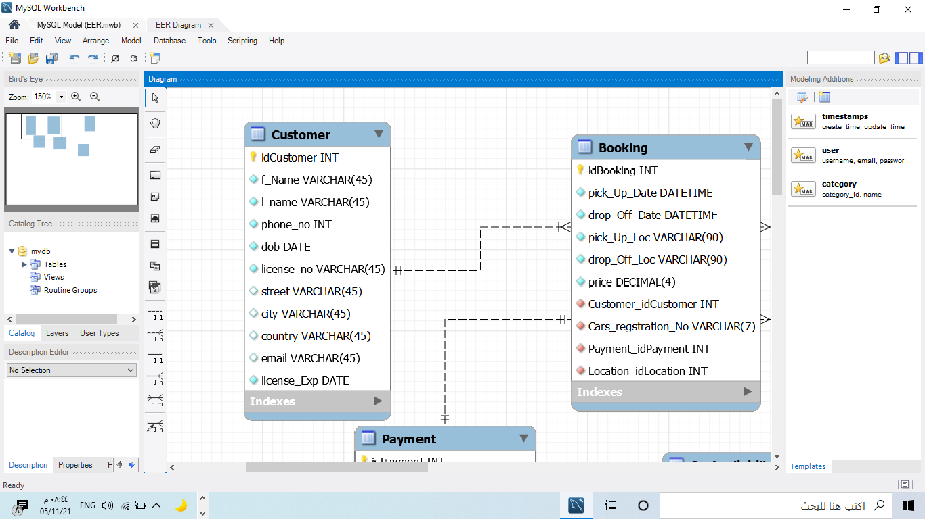
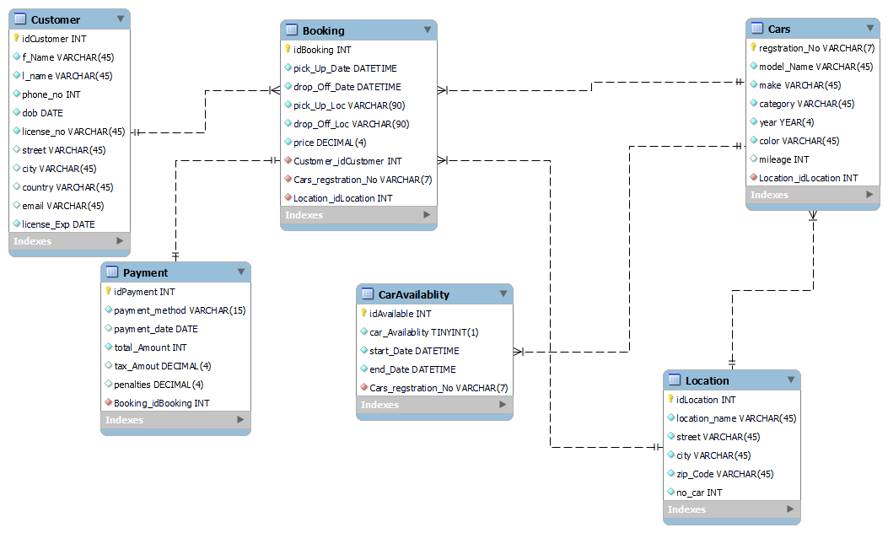
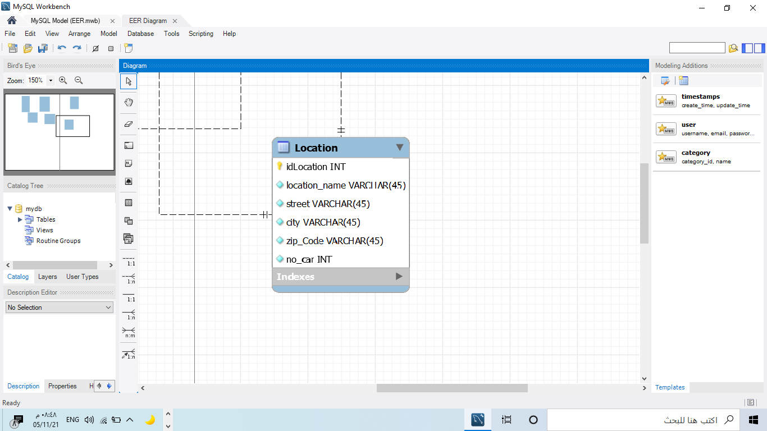
We R Everywhere Car Rental Database
6 Tables contain :
- Customer.
- Booking.
- Location.
- Car.
- Payment.
- Car availability .

Slide 4

We R Everywhere Car Rental Database
6 Relationships :
- The relationship between Customer and Booking is (1:N).
- The relationship between Payment and Booking is (1:1).
- The relationship between Cars and Booking is (1:N).
- The relationship between Location and cars is (1:N).
- The relationship between CarAvailablity and Cars is (1:N)
- The relationship between Location and Booking is (1:N).

Slide 5
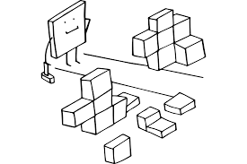
We R Everywhere Car Rental Database
Attributes Constraints:
License Number attribute is not null and unique
Car Availability formatted as TINYINT
CAR Registration No is limited to 7 characters
Date of birth attributes for the customer

Slide 6
Thank you!

